Slide 1
Data structures and algorithm Course Overview

Slide 2
Objectives
The primary objective of the course is to help students understand the importance of data structures and well-designed algorithms for efficient management of computing resources while programming.
Popularly employed linear and nonlinear data structures are described from the perspective of their specification, application, and implementation.
Several sorting and searching techniques are also discussed to help students design efficient solutions for real life problems.
Basic knowledge of algorithm’s complexity analysis is also provided for identification of time costly processes

Slide 3
Course Outline
Array
Searching algorithm
Sorting algorithms
Algorithm Analysis
Stack ,queue
Link list, double link list, circular link list,
Binary and binary search trees
AVL tree
Heap and heap sort
Hashing
Graphs
Minimum Spanning Tree
Greedy algorithms

Slide 4
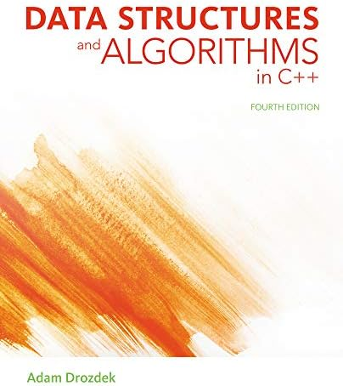
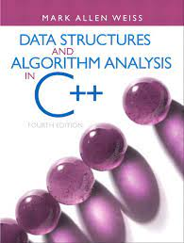
Recommended Books
Text Book
Data Structures And Algorithms in C++, 4/e, Adam Drozdek
Reference books
Data Structures And Algorithms Analysis in C++, 3/e, Mark Allen Weiss
Data Structures Using C++,Varsha H. Patil
Sedgwick R Algorithms in C++ Addison Wesley Reading, Mass 1998
Knuth D, The Art of programming Vol 1,2,3,Addison Wesley Reading Mass

Slide 5
Assessment breakdown 100 marks
Quizzes 10%
Assignments 20%
Mid term 20%
Final 50%
Four quizzes.
Three Assignments .

Slide 6
Contact & other Information
Email
lubnasiddiqui.bukc@bahria.edu.pk
Office
Engineering block
Second floor, Faculty 7
Find lectures and other relevant material on LMS

Slide 7
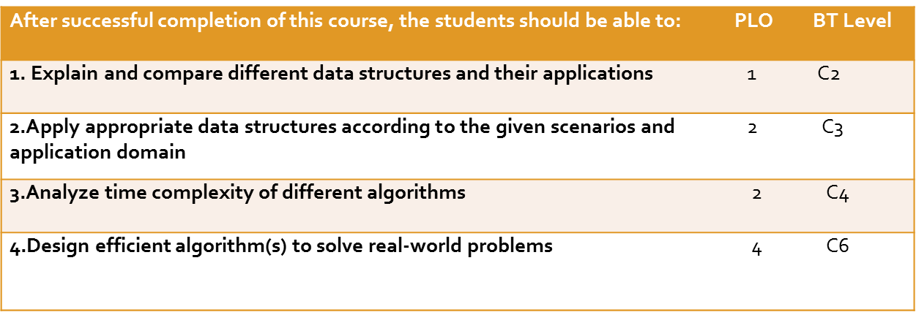
Course Learning Outcomes

Slide 8
